Slide 1
Data Essentials L3 DAY 3
Module 2: From Data to Insight

Slide 2

Recap
Describe benefits of using different file types.
Describe the benefits of data blending using examples.
Explain the difference between merging (joins) data and appending data.
Describe examples for when you would use each type of join (from your own role, or generic).
Challenge
Describe, using examples the common data issues / errors / challenges you / your organisation experience when using data.
Data preparation:
Recap, review,
discuss
Notes:
30 mins to make notes, then share with class
**IF ANYONE USING VM FOR PQ, ASK THEM TO SET UP NOW AND TRANSFER THE PQ FILES OVER TO THE VM**

Slide 3
Power Query

Slide 4
KSBs (1 of 2)
Power Query
K3₁ How to collate and format data in line with industry standards.
K6₁₊₂ The value of data to the business. How to undertake blending of data from multiple sources.
K8₁ How to filter details, focusing on information relevant to the data project.
K9₁ Basic statistical methods and simple data modelling to extract relevant data and normalise unstructured data.
Notes:
K8 and K9 may not be fully satisfied by this activity.

Slide 5
KSBs (2 of 2)
Power Query
S4₁ Blend data sets from multiple sources and present in format appropriate to the task.
S5₁ Manipulate and link different data sets as required.

Slide 6
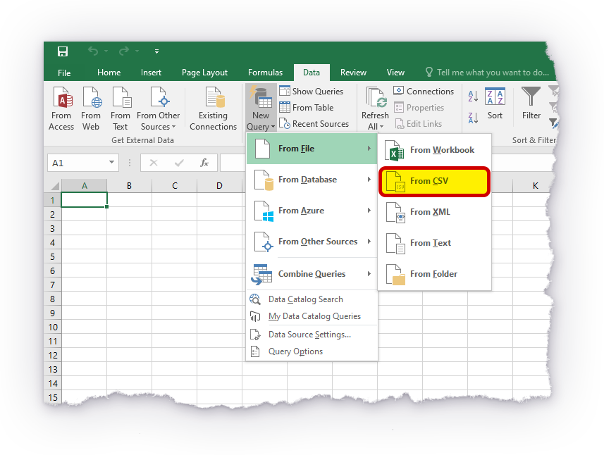
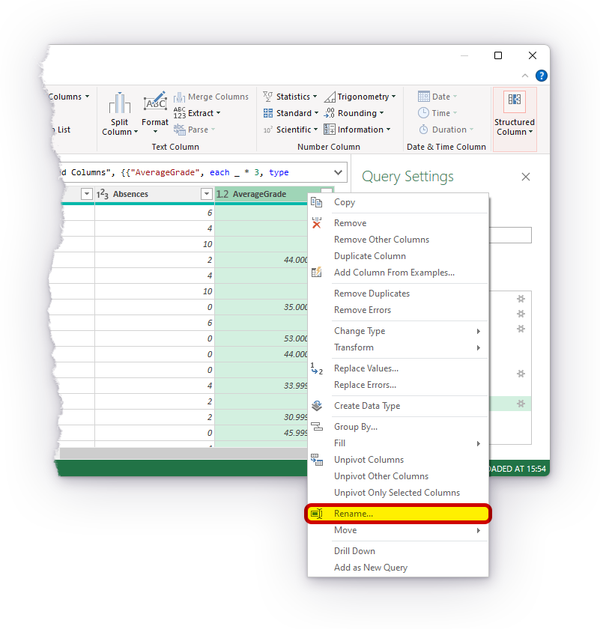
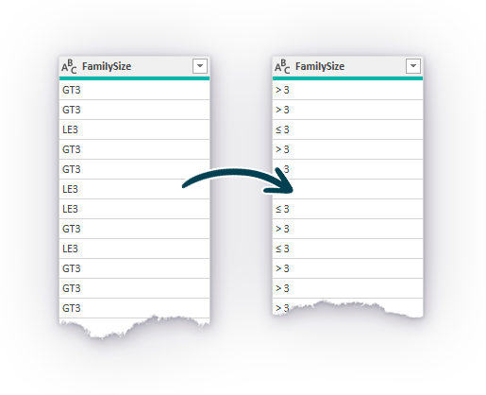
Introduction to Power Query
Download files
'Introduction to Power Query v0.4.9.pdf'
'student_grades.csv'
column_from_examples.csv
Open file
'Introduction to Power Query v0.4.9.pdf'
Notes:
ASK LEARNERS TO DOWNLOAD THE PDF AND DATASETS AND PUT INTO A FOLDER/AREA FOR EASY ACCESS LATER.
IF USING VM, DOWNLOAD AND PUT IN DESKTOP, THEN TRANSFER OVER TO VM.
NEXT SLIDE – GO OVER BEFORE ACTIVITY

Slide 7
INSPECT THE DATASETS
Download the learner guide and datasets.
Let’s take a look at both datasets and inspect the data together.
Take 5 mins to make notes on any issues you find in the student_grades dataset.
Discuss:
errors found.
implications of these errors.
how you would fix them.
Notes:
Look through both datasets.
Then ask learners to take 5 mins and make notes on any issues that they would resolve in the student_grades dataset.
Discuss issues and how they would resolve them.

Slide 8
Introduction to Power Query
Key learning points:
How to open and close the Power Query Editor.
The layout and core features of Power Query.
How to apply some of the most common data transformations.
We will go through basics of the interface and dealing with tables and queries together as a group to get you started.
Open file
'Introduction to Power Query v0.4.9.pdf'
Notes:
Ask learners to take 5 mins to skim read up to page 8 (on the pdf page numbers).
Go through pages 8-15 as a group (import, create new query, load, transform, access queries and connections, make changes in PQ,
load changes back to Excel. Go back to PQ and undo in applied steps. Make changes in Excel, do not reflect in PQ. Changes in Excel then create a new query. Delete the query, etc.
3. Learners to start from page 16. Check in before lunch.
Key learning points:
How to open and close the Power Query Editor.
The layout and core features of Power Query.
How to apply some of the most common data transformations.
Note to tutors: this activity was originally intended to be an Online activity. As such, it was designed to be achievable by most learners without too much tutor assistance. However, given that this is a Live Event, learners should be encouraged to take full advantage of having a tutor on-hand for assistance.

Slide 9
Apply
Workplace
Activity
Review
And
support
Review the apply workplace activity.
Read the brief.
Ask questions if needed.
Notes:
If time, learners who have completed early to review the apply activity (read the brief) and if needed, ask questions.

